Slide 1
A Presentation On BURGLARY CLAIM –A CASE STUDY
December 4, 2012
Tania Saulat - Director
Khalid and Associates (Pvt) Ltd.
Insurance Surveyors & Loss Adjusters

Slide 2
Overview of Cover - Definition
Legal Definition:
“dishonestly appropriating the property of another with the intention of permanently depriving them of it”.
Policy Definition:
“loss or damage by theft / burglary accompanied by actual forcible & violent breaking into or out of the premises”.

Slide 3
Exclusions, Warranties & Conditions
Exclusions
Persons legally on premises
Un -occupancy
Riots , strike etc
Market exclusions – War, Sonic Bangs, Pollution etc
Warranties & Conditions
Armed Guard round the clock
Intruder Alarms
Keys not on premises
Police notification condition

Slide 4
The Case
The Insured are traders of chemical dyes, purchasing locally as well as importing stock.
Stocks of dyes in boxes stored at their warehouse premises.
Premises Insured - Fire Policy with extensions for AD, SRCC & Burglary.
Insured’s Premises Burgled.

Slide 5
Claim Management Process
Information gathering & analysis can be divided into:
Physical Evidence
Documentary Evidence

Slide 6
Physical Evidence
Violent & Forcible Entry or Exit
Telltale signs of Removal
Witness Statements
Photographic Evidence
Initial notes etc

Slide 7
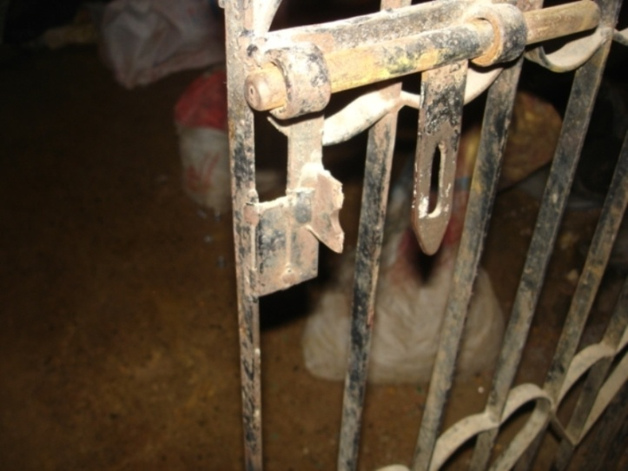
VIOLENT AND FORCIBLE ENTRY EVIDENT

Slide 8
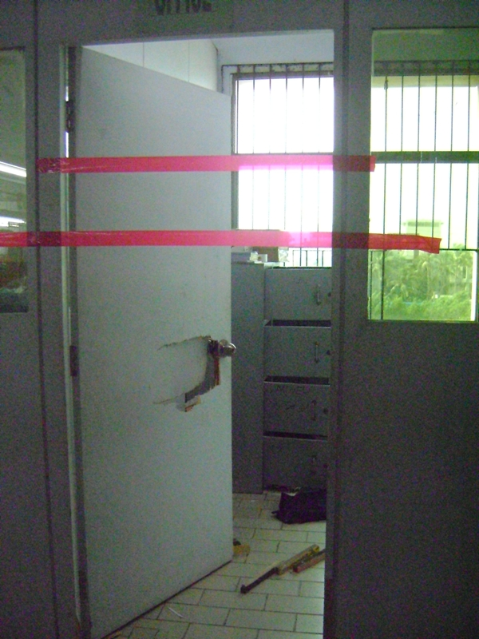
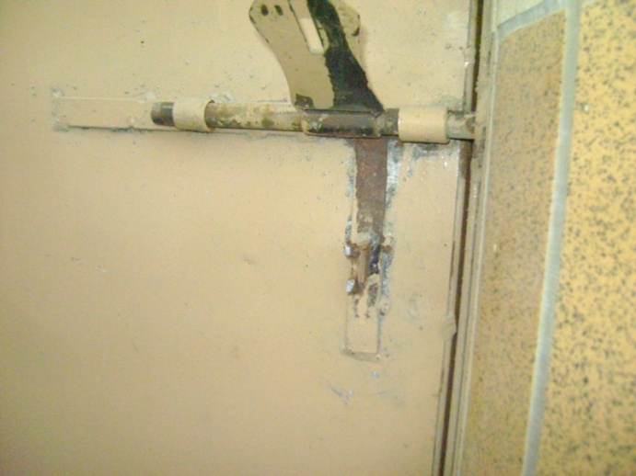
WAREHOUSE GATE AND OFFICE DOOR FORCED OPEN

Slide 9
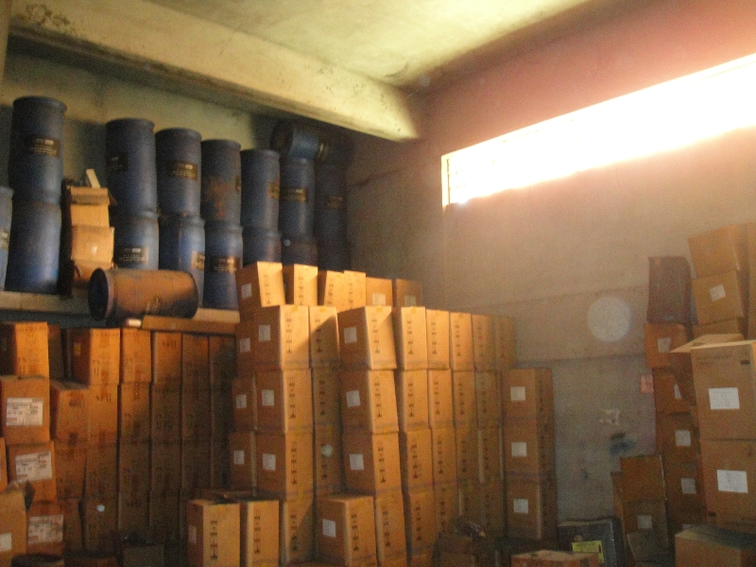
REMOVAL OF STOCK EVIDENT

Slide 10
Documentary Evidence
Essentials for burglary losses:
A range of information & documents collected and verified:
Claim Form
Police Report
Computerized Stock Reports
Manual Stock Registers
Import Documents
Issuing Reports
Receiving Reports
Gate Passes

Slide 11
Liability Considerations
Insurable Interest
Policy Period / Cover
Insured Peril
Adequacy of Cover / Average Applicable
Other Insurances
Recovery / Subrogation
Compliance with Conditions / Warranties

Slide 12
Liability Substantiated, Indemnity Considered
The Intention – arriving at a level of Indemnity fair to both the Insured & the Insurer.
The Actual Process- presents numerous complications and challenges.

Slide 13
Quantifying the Claim
Stock Register & Other Documents Provided
Extensive Physical Verification Conducted
Findings Compared to Stock Register:
Stock Found Sound Marked (Y)
Stock Not Found Marked (X)
Findings endorsed by Insured’s warehouse In charge.

Slide 14
Verification / Reconciliation
Claim, Stock Register, Receiving Reports etc received.
Sets of documents reconciled in light of Claim.
Findings:
Quantities in Computerized Stock Report & Manual Register not consistent.
The sets of Documents cannot be reconciled/ inconsistencies noted.
Shortfalls between Stock not Found (X) & Claim.

Slide 15
Cont…
Insured informed, meetings held
Revised claim submitted
Records not reconciled, Delays in Updating i.e. inaccurate reflection of quantity lost / indemnity.
Evidence needed for detailed analysis of records.

Slide 16
Quantities of each item claimed considered in light of documents:
Commodity X
Manual Stock Register Qty: 23
Physical Qty Found: 15
Claimed Qty: 7
Computerized Stock Report Qty (verified): 16
Qty Therefore Considered: 1

Slide 17
Cont…
Commodity Y
Manual Stock Register Qty: 20
Physical Qty Found: 10
Claimed Qty: 10
Computerized Stock Report Qty (verified): 20
Qty Therefore Considered: 10

Slide 18
Cont…
2nd Revised Claim Submitted, Insured
Meetings Held
Independent Findings Presented to Insurers.

Slide 19
Problems Encountered / Lessons Learned
Irregular / Inconsistent Records
Policy Condition
Documents used as basis
Negligence in updating records
Average / Underinsurance
VAR > Sum Insured
Gaps in Cover. Not fully Indemnified
Premium Inadequate/ Exposure not known
Impacts Relations
Unnecessary Complications

Slide 20
Thank You

