Slide 1

Claims Management for Life Insurance
Delivering on a Promise
Zain Ibrahim
EFU Life Assurance Ltd

Slide 2


A widow’s statement
“…My husband died suddenly due to an electric shock which has left me and my children in utter despair…”
“…My life ended the day he died. Our once blissful and happy life turned into misery and desolation…”
“…All three of my young children think of their father and weep. His untimely and sudden death has left me and our children in a very bad state…”
“…We only pray to GOD to grant us the tolerance to bear this great burden..”

Slide 3

Life Insurance is
an emotional business

Slide 4

Agenda
Life insurance: Key players and statistics
Claims philosophy
Life insurance contract
Claims definitions, types and statistics
Parties

Slide 5
Agenda
Claims Management Process
Duty of disclosure
Fraud in claims and Anti fraud measures
Conclusion

Slide 6








Life Insurance Industry
Players
(Public
And
Private Sectors)
State Life
Met Life
EFU Life
East West Life
Jubilee Life
Pak Qatar Family Takaful
Adamjee Life
Dawood Family Takaful

Slide 7
Life Insurance Industry
Market Share
2011
Private and Public Sector
(Excluding Adamjee Life)
Amounts in Millions

Slide 8
Life Insurance Industry
Market Share
2011
Private Sector
(Excluding Adamjee)

Slide 9
Agenda
Life insurance: Key players and statistics
Claims philosophy
Life insurance contract
Claims definitions, types and statistics
Parties

Slide 10

Claims Philosophy
Principles approach;
  All genuine claims must be paid, invalid must not!
  Fairly, accurately and promptly
Pro-active approach;
  Handling claims, especially questionable claims
Prophylactic approach;
  Learning from claims process

Slide 11
Agenda
Life insurance: Key players and statistics
Claims philosophy
Life insurance contract
Claims definitions, types and statistics
Parties

Slide 12

Life Insurance Contract
It’s all about Claims!!!
The contract must say what the contract must say!
Not open to misinterpretation!
Less dependency on medical & legal opinions

Slide 13
Agenda
Life insurance: Key players and statistics
Claims philosophy
Life insurance contract
Claims definitions, types and statistics
Parties

Slide 14
Types of Life Insurance Claims
1) Death Claim
  Natural Death Claim
  Accidental Death Claim
2) Living Benefit Claim
  Disability Claim
  Critical Illness Claim
  Maturity Claim

Slide 15
Claims paid by EFU Life

Slide 16
EFU Life Death Claims: All Causes

Slide 17
Agenda
Life insurance: Key players and statistics
Claims philosophy
Life insurance contract
Claims definitions, types and statistics
Parties

Slide 18


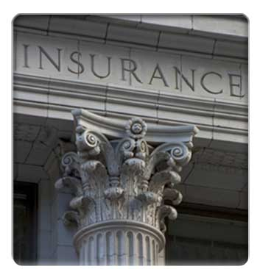
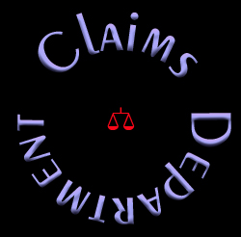
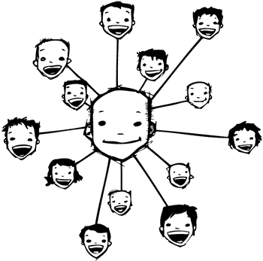


Parties – External
Claimant
Investigation
Non Medical Sources
Sales Force
Courts
Medical Sources

Slide 19
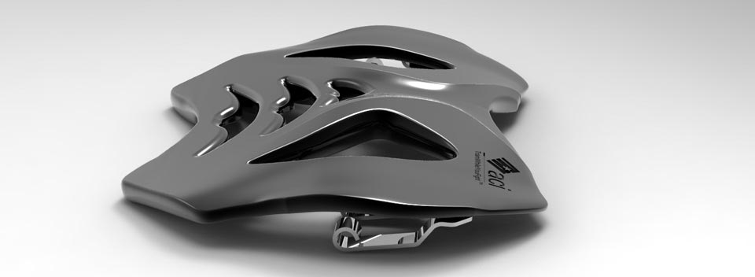



Parties – Internal
Product Design
Underwriting
Marketing
Profitability

Slide 20
Agenda
Claims Management Process
Duty of disclosure
Fraud in claims and Anti fraud measures
Conclusion

Slide 21
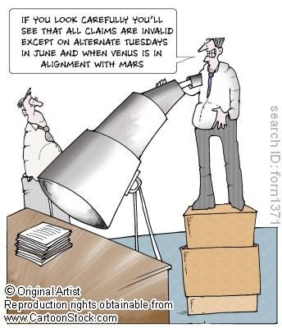
Claims Management Process

Slide 22
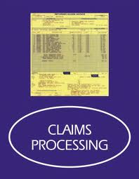
Claims Management Process - Objectives
Pay genuine claims
Timely claim settlement
Reduce claim cost
Detect fraud
Derive information for data driven decision making

Slide 23




Claims Management Process
Claim Lodgment
Claim Entry
Assessment
Claims Processing
Claims Follow-up
Settlement
Investigation

Slide 24

Claims Management Process - Problems
Lack of documentation in rural areas
Language Problems: Sindhi, Siraiki, Punjabi, Pushto
Unreadable Police Records
Collusion by other parties: Doctors/Hospital staff
Collusion by friends and family

Slide 25
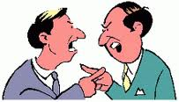
Reasons for Disputes
Signature on documents without reading
Misinterpretation of policy
  wordings
Mis-commitment by sales staff
Non-acceptance of material non-disclosure

Slide 26
Agenda
Claims Management Process
Duty of disclosure
Fraud in claims and Anti fraud measures
Conclusion

Slide 27

Duty of Disclosure
Contract of utmost good faith
Material information
Fraudulent material misrepresentation

Slide 28
Agenda
Claims Management Process
Duty of disclosure
Fraud in claims and Anti fraud measures
Conclusion

Slide 29
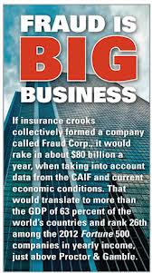
Insurance Fraud
About
USD 80 Billion a year in US alone!

Slide 30
Insurance Fraud
Definition:
Intent to defraud the insurance company
Types:
Hard Fraud: Deliberate plan/ invention of a loss
Soft Fraud: Exageration of otherwise legitimate claim

Slide 31

Anti-Fraud Measures
  Non-reliance on documentation
  Proactive claims management
  Effective underwriting
  Watching out for red flags
  Using claims investigation agencies
  Training

Slide 32
Agenda
Claims Management Process
Duty of disclosure
Fraud in claims and Anti fraud measures
Conclusion

Slide 33

Conclusion
Get back to basics! Do we need every piece of paper!
Clarification at the time of policy issuance
Training of sales force
Feedback from claims to underwriters
Does it make sense!

Slide 34
A widow’s statement
“…My husband died suddenly due to an electric shock which has left me and my children in utter despair…”
“…My life ended the day he died. Our once blissful and happy life turned into misery and desolation…”
“…All three of my young children think of their father and weep. His untimely and sudden death has left me and our children in a very bad state…”
“…We only pray to GOD to grant us the tolerance to bear this great burden..”
The widow allegedly murdered her husband with the help of an accomplice

Slide 35
Thank you for your attention!

