Slide 1
A Presentation On Textile Fires in Pakistan
December 4, 2012
Syed Imran Rabbani
Joint Executive Vice President
Jubilee General Insurance Company Ltd.
Claims Department – Head Office, Karachi

Slide 2
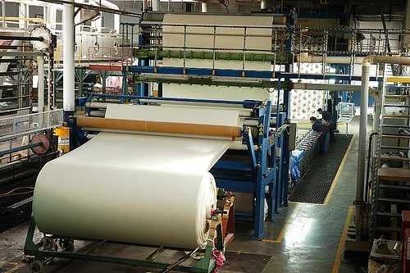
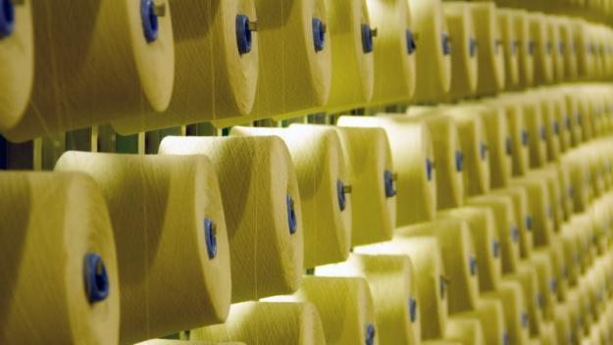
PRESENTATION OUTLINE
Textile Industry Background
Textile Industry Main Functions
IAP Data Analysis
Role of Risk Management
Claims Management

Slide 3
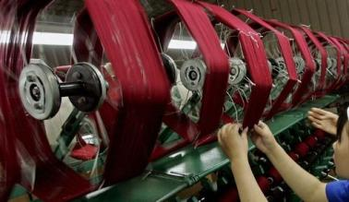
TEXTILE INDUSTRY PAKISTAN
Textile sector plays a pivotal position in the exports of Pakistan
Pakistan is the 8th largest exporter of textile products.
World Textile Growth Rate is 2.5 percent per annum
Pakistan’s Global Share constitutes to less than one percent
Pakistan has at present:
1,221 Ginning Units
650 Spinning Units

Slide 4
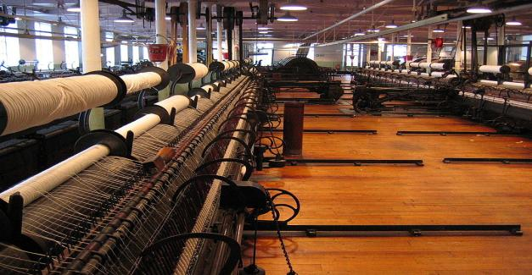
TEXTILE SECTOR:
Exports 52% OF TOTAL EXPORTS
Manufacturing 46% OF TOTAL MANUFACTURING
Employment 30% OF TOTAL LABOUR FORCE ABOUT 15 MILLION PEOPLE
Gross Domestic Product 8.5% OF TOTAL GDP

Slide 5
PAKISTAN’S TEXTILE EXPORT SPLIT- FY 2011

Slide 6
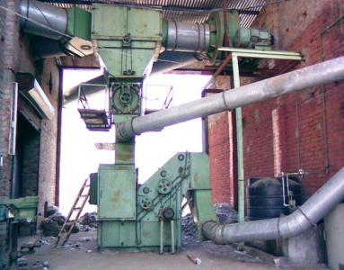
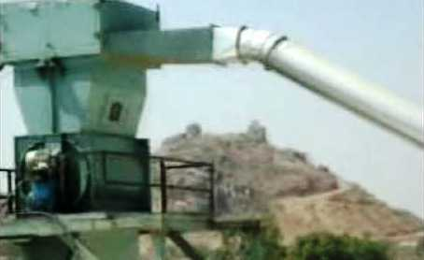
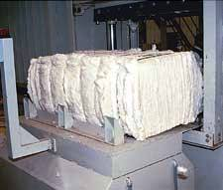
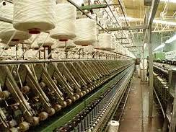
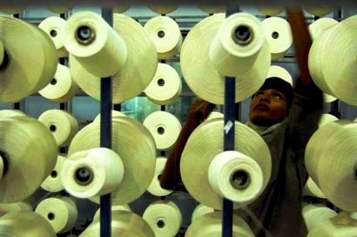
BASIC TEXTILE FUNCTIONS:
Ginning: The seed cotton goes in to a Cotton gin. The cotton gin separates seeds and removes the "trash" (dirt, stems and leaves) from the fibre. The ginned cotton fibre, known as lint, is then compressed into bales
Spinning: The process of making fibrous material into yarn or thread. It includes:
Opening & Loosing
Carding
Combing
Drawing
Roving
Winding

Slide 7
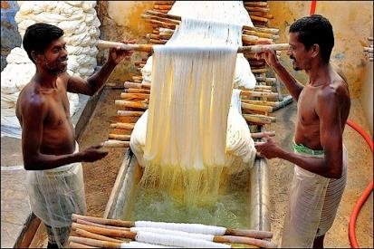
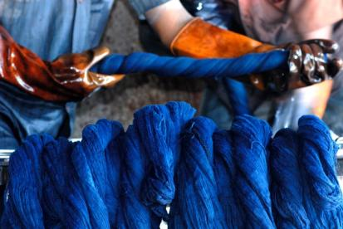
BASIC TEXTILE FUNCTIONS:
Bleaching: In this process, the natural or original color of the textile is removed by chemicals or exposure to sunlight.
Dyeing: This process involves adding color to textiles. A vast range of dyes, natural and synthetic are available, some of which require mordents.

Slide 8
STATISTICS- LOSS RATIO LAST 3 YEARS

Slide 9
ANALYSIS
It is clearly evident that Average Loss Ratio for past three years of the following Textile Functions pose a huge financial impact on the insurance sector
The traditional focus of an underwriter is usually on areas such as Cotton Spinning, Weaving and Ginning.
The underwriters must also focus their attention and strategically manage these areas as well.
Cotton Garments 148%
Cotton Dyeing & Bleaching 73%
Cotton Mill 78%

Slide 10
ANALYSIS Cont….
For the past three years 2009 – 2011
These huge number bring us to a fact that much emphasis is needed to readdress the Risk Analysis and the Underwriting in order to bring up such strategies which are mutually beneficial to each and every stakeholder.
Average Sum Insured Rs. 1.13 Trillion
Average Premium Rs. 2.03 Billion

Slide 11
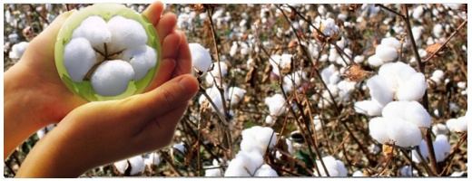
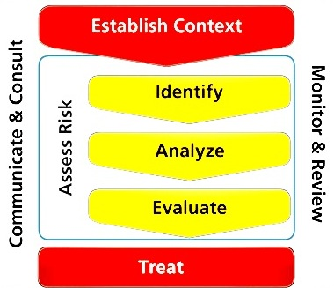
RISK MANAGEMENT
The Risk Management is now becoming the utmost important step, which gives the underwriter vital information and highlights the flaws which if countered before insurance cover is issued, can have a colossal impact on the balance sheet of the company.
Risk Management Steps:

Slide 12
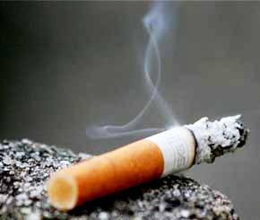
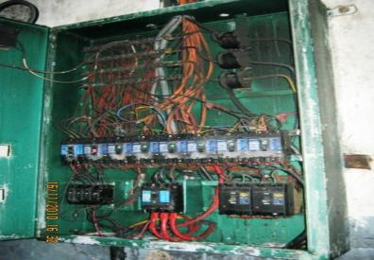
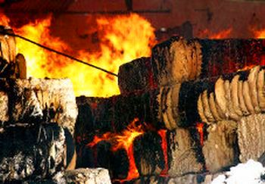
POSSIBLE CAUSES OF FIRE
Fire Packed Bales
Electrical Faults (Short Circuiting)
Mechanical Equipment (e.g. Defective Lift Trucks)
Friction
Lightning
Cutting & Welding
Smoking

Slide 13
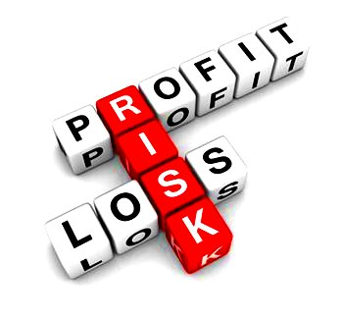
RISK MANAGEMENT
The few necessary Risk Countering Measures which needs to be undertaken are as follows:
An automatic fire alarm system conforming as per insurance "Code of practice for selection, installation and maintenance of automatic fire detection and alarm system" would be advantageous for cotton godowns.
Proper separation must be there as per “Defined Separation in Insurance Tariff” and use of measures as per tariff must be made mandatory e.g. Double Fire Proof Door etc.
Portable fire extinguishers provided in many mills were often found to be non-standard ones. Mill management should purchase only reliable extinguishers and must ensure proper refilling at the time of expiration of the same and they must be provided at suitable locations in the vicinity of godowns.

Slide 14
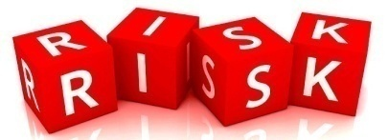
RISK MANAGEMENT
Installation of fire hydrant system as per Tariff norms is recommended.
For extinguishment of flash fires involving cotton in process, DCP type extinguishers backed up with low velocity water spray system are more effective and must be installed.
Installation of a sprinkler system. Automatic sprinklers are recommended for all processes and high value storage areas.
Smoke detectors would be appropriate for fire detection.
Wherever neither hydrant nor sprinkler system is available, a water tank of at least 50,000 litres becomes a necessity.
Proper Storage Practices
The risk managers must ensure that maximum safety measures must be implemented and must also highlight contingency measures to provide alternatives in case of failure of a system installed. This effectively helps to reduce the overall risk and in turn helps the client do a better safe guard of its assets.

Slide 15
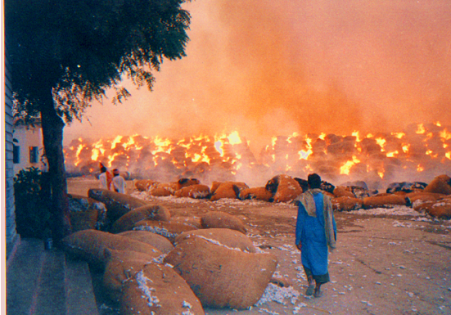
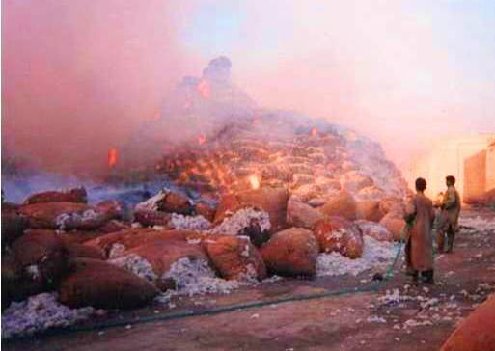
ASTOUNDING FIRE LOSSES TEXTILE SECTOR
Cotton/Phutti in Boras

Slide 16
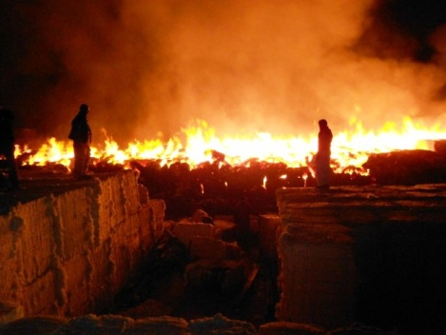
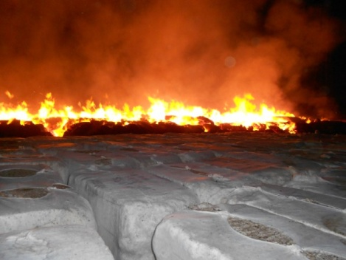
ASTOUNDING FIRE LOSSES TEXTILE SECTOR
Fire in Bales

Slide 17
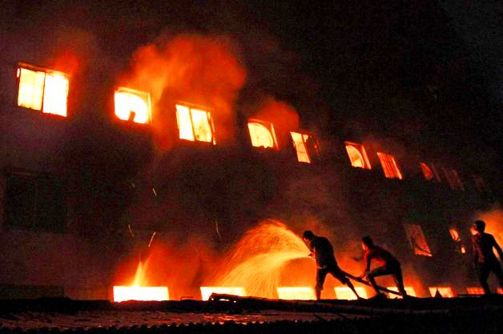
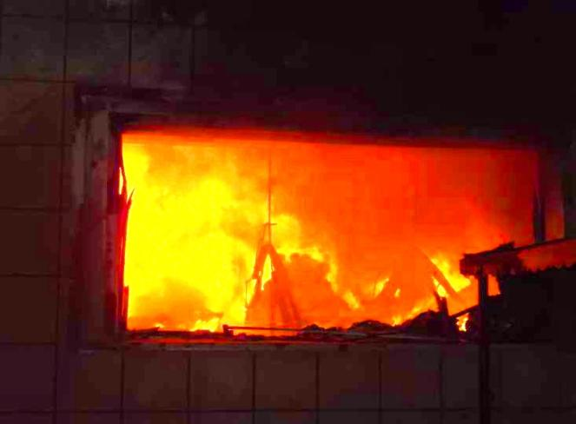
ASTOUNDING FIRE LOSSES TEXTILE SECTOR
Textile Unit

Slide 18
CUSTOMER EXPECTATIONS
Out of any insurance contract, the customer has the following Expectations:
Adequate insurance coverage, which does not leave the insured high and dry in time of need, with right pricing.
Timely delivery of defect free policy documents with relevant endorsements / warranties / conditions / guidelines.
Should a claim happen, quick settlement to utmost satisfaction.

Slide 19
CLAIMS MANAGEMENT IN GENERAL INSURANCE IMPORTANT ASPECTS
General insurance being a market driven service industry, the customer has to be kept satisfied. With so many options available, a customer once lost is most likely a loss forever.
Remember!!! A dissatisfied customer is a bad publicity. It has all the potential to damage the reputation of the company.
Claim settlement can be used as a marketing tool. Bringing in a new customer is much more costly than retaining the existing ones.
In a de-tariffed market, pricing will be the key factor. Proper claims management – quick settlement at optimal cost will help keep the price competitive.

Slide 20
CLAIMS MANAGEMENT IN GENERAL INSURANCE IMPORTANT ASPECTS CONT…..
Note!!! It is an accepted fact that most of the customers complaint relate to claims. Therefore, it should be the endeavor of an insurance company to ensure that such complaints do not occur in the first place and in some cases if they do occur it is attended promptly, efficiently and transparently.
Delayed claim settlement generally result in higher claims cost. Claims cost is a very important factor impacting on the profitability of the company.
Claims must be monitored as they progress. A little time spent thinking clearly right from the beginning will avoid a lot of unnecessary and time consuming patch-ups and straightening out later on. Unpleasant decisions conveyed timely with proper justification is better than procrastination which is bound to create more problems and unpleasant situations.

Slide 21
TRADITIONAL CLAIMS HANDLING
Claims Process:-
As soon as a claim is reported, the claims handler checks as to whether the cover was in force at the time of loss and whether the peril is covered under the policy.
A surveyor is appointed who visits the spot, does the assessment and submits the report.
The claims handler examines the report, calls for relevant supporting documents.
On receipt of survey report and documents, the same are examined.
The claim file is processed and settlement is offered.

Slide 22
CLAIMS MANAGEMENT STEPS- VIEWPOINT
Risk inspection:
Risk Inspection is also a part of Claims Management
Effective Guidance:
It is of utmost importance that the client is made aware in very clear terms about what exactly is covered and what is not
Adequate Reserving:
Adequacy of claims reserving is important for any insurance company to meet its claim obligation

Slide 23
CLAIMS MANAGEMENT
Loss Adjuster:
Relevant Selection must be done based on certain decisive factors
Time is of the Essence:
Immediate deputation of the Loss Adjusters and prompt actions by the Claim Handlers are vital to success
Record Retention
The proper maintenance and unveiling (at the time of risk Inspection) of the above does not give rise to the following:
1) Average Clause 2) Under-Insurance

Slide 24
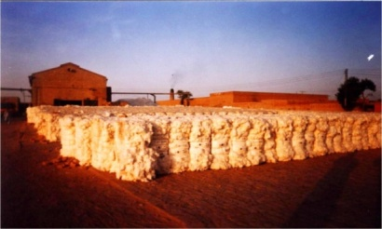
CLAIMS MANAGEMENT SALVAGE HANDLING
Salvage is very important and every precaution must be taken to safeguard it.
Claims handler must coordinate with the loss adjusters and the insured to effectively save the property from being at maximum loss.
All bales must be removed to a safe outside location.
Keep a good supply of water .
Wetting agent must be available in a substantial quantity
The bales not burnt must immediately be separated one by one without removing the bands or wires which in turn exposes more lint to the fire and threatens the loss of entire bale.
Salvaging crew should be ready to move the cotton out of the involved sheds as rapidly as possible.
The path on which the bales are removed must be monitored carefully and a hole or a dig must be made in two or three instances so that a fire path cannot be made .

Slide 25
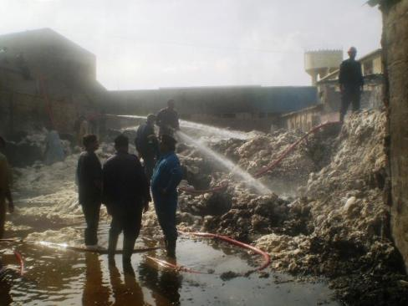
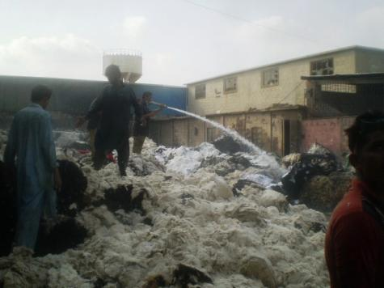
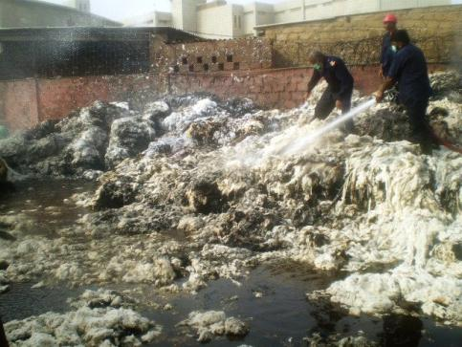
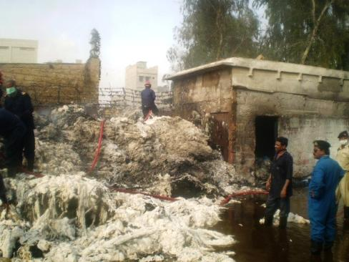
SALVAGE MANAGEMENT

Slide 26
CLAIMS MANAGEMENT SALVAGE HANDLING CONT……
The losses involving inventory or stock such as Grey Cloth, Yarn etc requires efficient and timely coordination of the claims manager with the loss adjusters & client for salvage purpose because of the fact that these items if are in prolonged contact with the water can be devastated completely.
Hence, immediate action must be taken to cater for the same and the items are then handed over to the highest bidder to ensure maximum recovery i.e. Loss Minimization
The claims handler simply cannot waste time in making a decision and wait for the bids from salvage dealers, as doing so may deteriorate the goods to considerable extent with every hour passing by.
If the Insurers and Loss Adjusters sincerely make a joint effort then, salvage at times, been sold while the fire has not even been fully controlled.

Slide 27
CLAIMS MANAGEMENT IS AN ART NOT A SCIENCE
THANKS & BEST REGARDS!!!

