Slide 1
Power Plant Losses - Examples from Pakistan
Mansoor Ali Khan
General Manager
Hamid Mukhtar & Company (Pvt) Ltd.
Karachi Insurance Institute
December 4th 2012

Slide 2
Outline
Introduction to Power Plants
Common Types of Failures
Examples of PP Losses 2007-2012
Concluding remarks

Slide 3
‘A good presentation should be like a mini skirt. Short enough to arouse interest and long enough to cover the subject’
TED

Slide 4
Accidents don’t happen – They are caused
That’s why loss adjusters have jobs!

Slide 5
Power Plant Prime Movers
Steam Turbines
Gas Turbines
Hydro Turbines
Wind Turbines
Internal combustion engines
Solar Photovoltaic cells
Nuclear Reactors

Slide 6
Common Causes of Failure
Gas, Steam & Hydro Turbines
Ruptures, High Cycle Fatigue, Blade failures, Design failures
Wind turbines
Lightning, Electrical Fires, Gearbox failures, Remote locations
IC Engines
Overheating, Lubrication failure, High speed equipment (Turbochargers), Fire
Generators
Ruptures, Short circuits, Explosions, Fire
Transformers
Explosion, Fire ,Insulation failures
Boilers
Explosion , Fire

Slide 7
Business Consequences
Reduces capacity available to Grid
Delays in construction
Loss of revenue
Delayed startup
Business Interruption
Losses to Insurers / Reinsurers
Impact on Renewal Premiums

Slide 8
Power plant Losses in Pakistan 2007-2012
IPP Gas Turbine Compressor Blade & Shaft damage – MBD/ BI
Faulty design of air intake filter system. Blade fouling and damage to 9 stages
Property damage & BI Claim US$ 10.5 m
IPP HFO Diesel Generator – Alternator Damages – EAR/ DSU
Design fault in Alternator Base foot design
COD delayed 6 months
Loss paid under Warranty by OEM

Slide 9
Power plant Losses in Pakistan 2007-2012
50 Mw Wind Power plant under construction
Turbine Rotor blade damaged due to sudden wind/ rainstorm.
Turbine Rotor assembly damaged during lifting operation for mating with Nacelle on Mast
730 Mw Steam Turbine Plant
Plant site submerged due to overflow from breached irrigation canal during heavy rains
Property damage and BI Claim US$ 50 m

Slide 10
130 Mw Hydel Power Project - Flood Loss
2 Project sites – Weir Site and Power house
Connected by 9 tunnels
Loss occurred due to unprecedented rainfall and flooding in July 2010
Claimed loss Rs 2.3 billion (US$ 28.75 m)
Still not restored eg. Tunnels blocked with debris
Many Local and Chinese Workers buried under debris

Slide 11
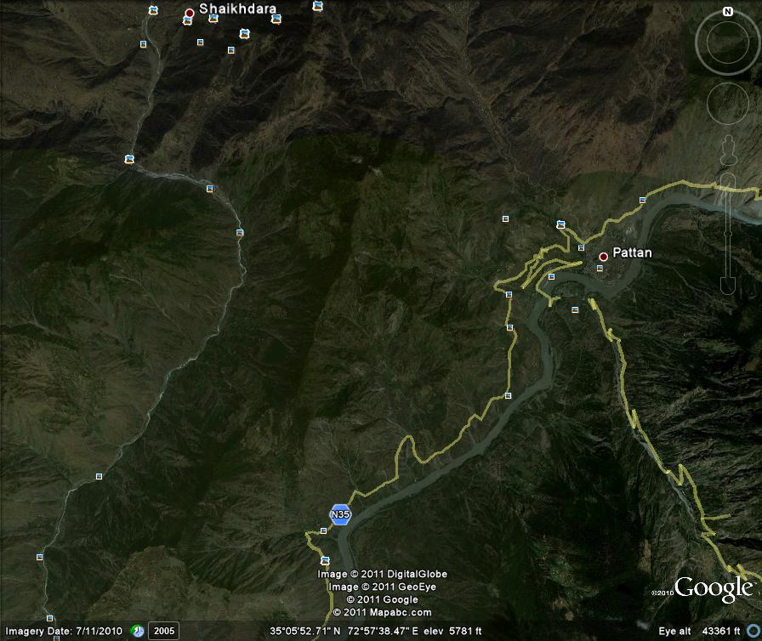
Weir Site
Power House Site

Slide 12
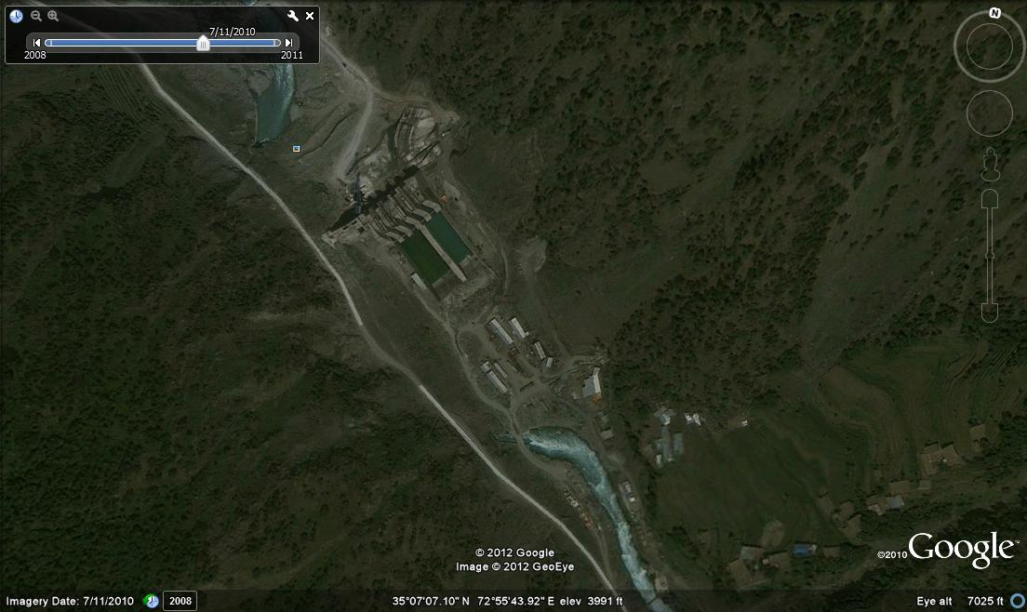
Weir Site - before flood
Camp Site

Slide 13
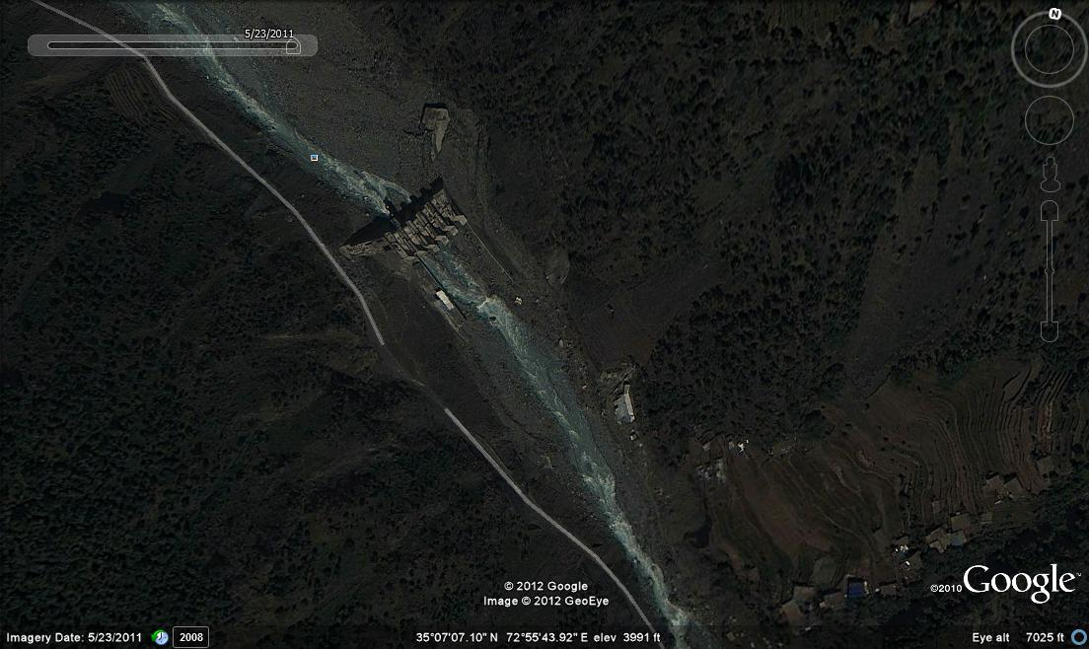
Weir Site, Stilling Basin and Campsite washed away

Slide 14
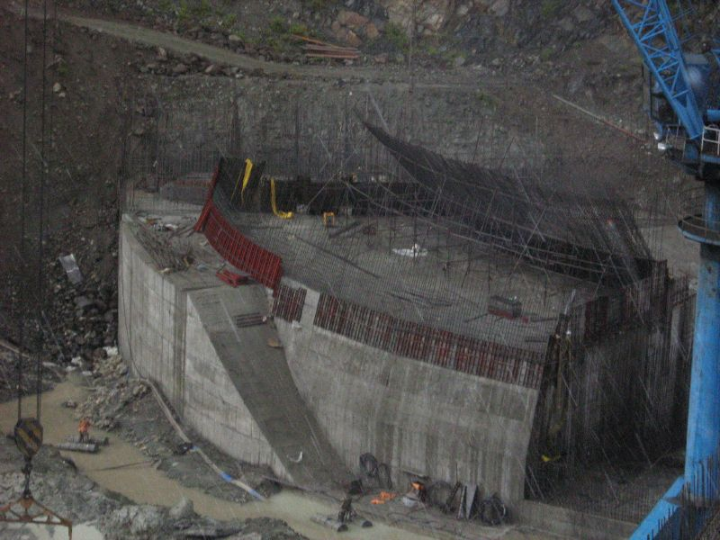
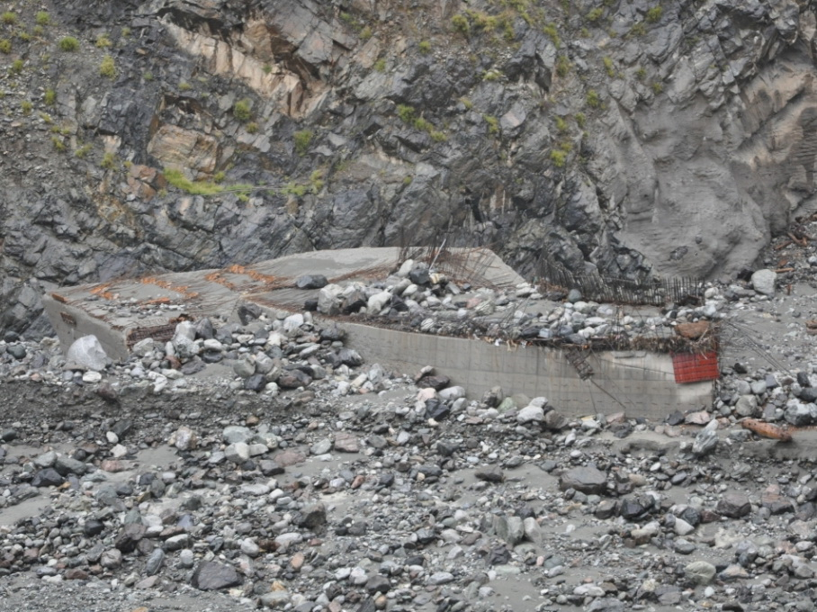
Covered with debris
Powerhouse building

Slide 15
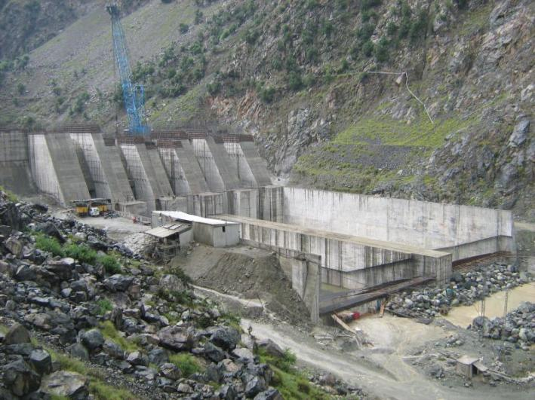
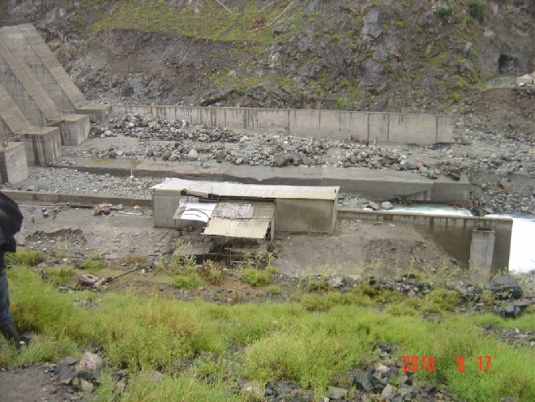
Stilling basin
Filled with debris

Slide 16
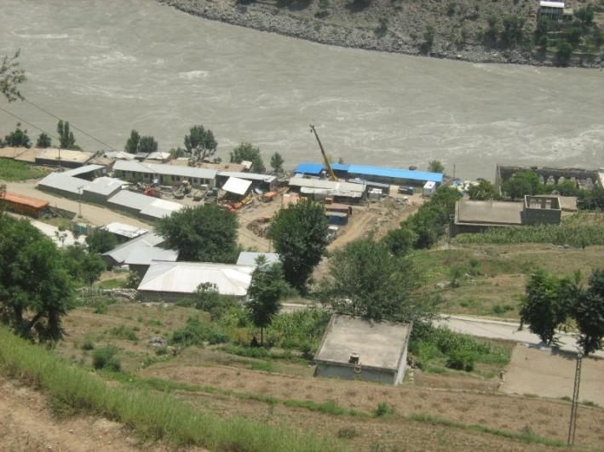
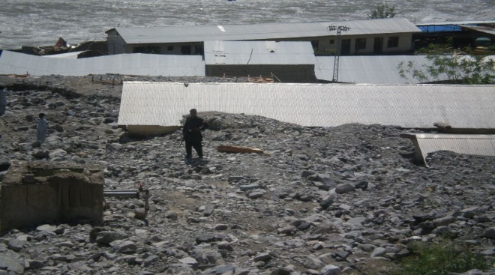
Buried Under Debris
Power House Campsite

Slide 17
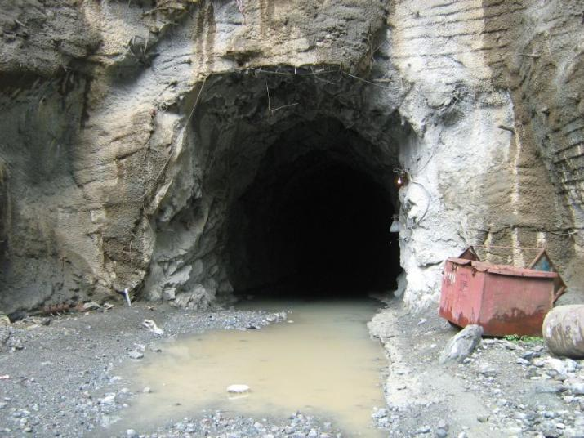
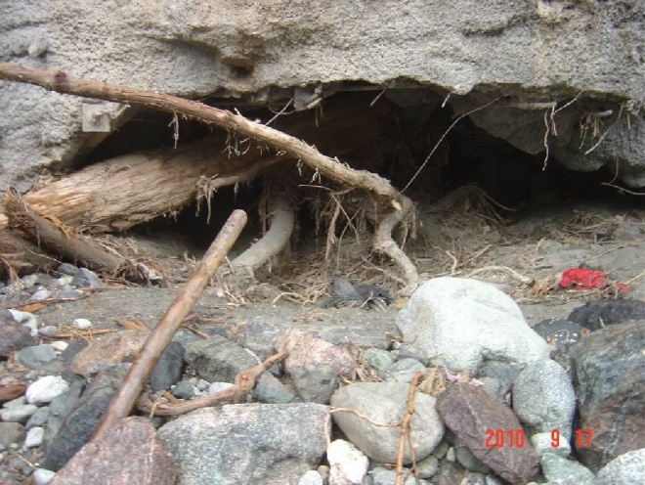
Tunnel exit
Exit blocked by Debris

Slide 18
IPP CC Gas Turbine Rotor damage – EAR / DSU
Rotor blades, Stator Vanes, Rotor shaft damage
COD delayed 120 days
Property damage Claim US$ 17.5 m
DSU Claim US$ 3.1 m
Human Error during commissioning

Slide 19
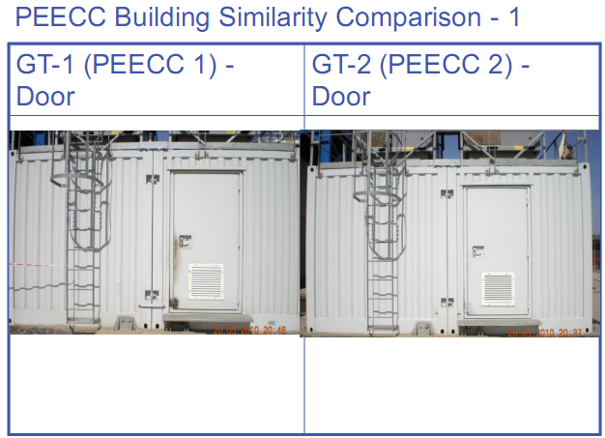
GT-1 Control Cabin GT-2 Control Cabin

Slide 20
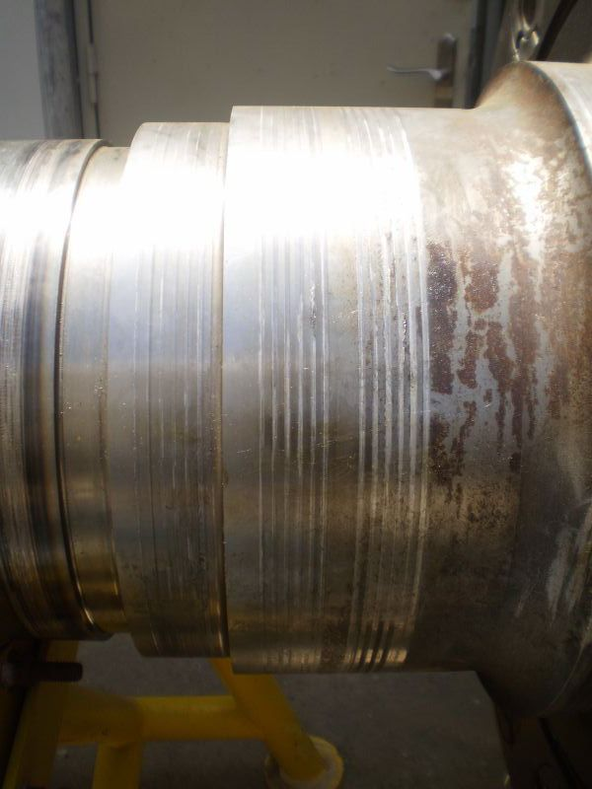
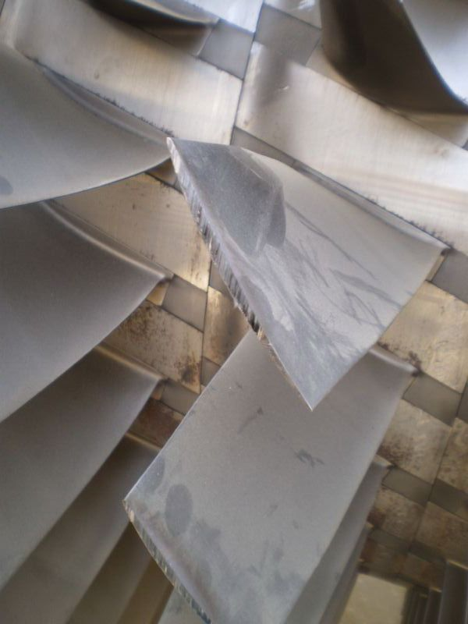
Thrust collar
Rotor Blades

Slide 21
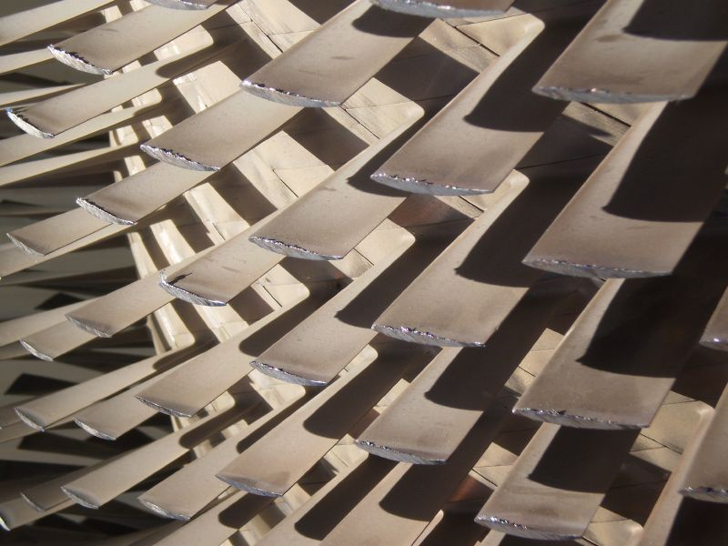
Damaged Rotor blade tips

Slide 22
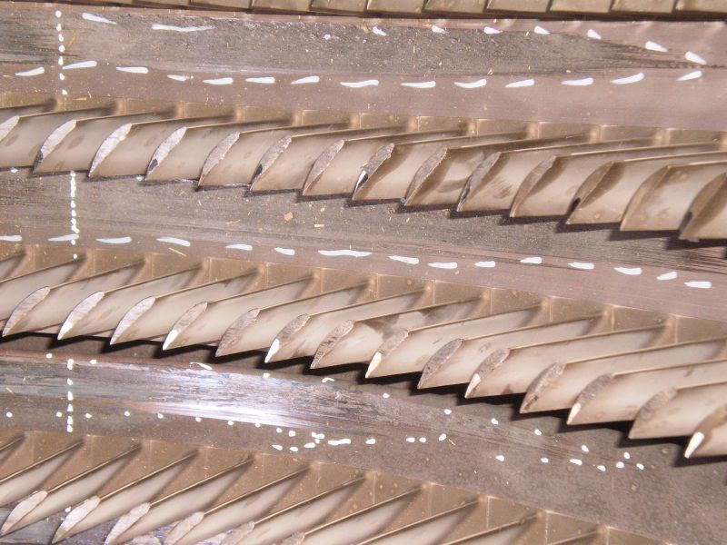
Damaged Stator Vanes

Slide 23
IPP Steam Turbine Rotor damage – MBD/ BI
Metal chipped off Bearing thrust collar journal
Property damage – Within deductible
Business Interruption Claim US$ 400 k
Out of service 95 days

Slide 24
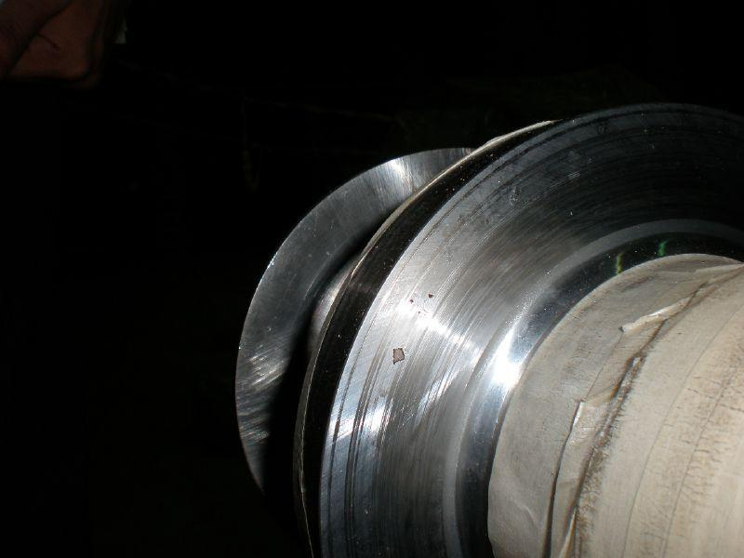
Chipped of metal from Steam turbine rotor bearing thrust collar

Slide 25
Hydro Power Flood Loss
Run of the river Hydro Power project 96 MW being constructed on the Indus River.
Overtopping of Coffer Dam
Turbines, Generators, LV and HV switchgear, Panels etc. were submerged in Water for many days.
Property Damage claim is approx. USD 55 million
No DSU cover

Slide 26
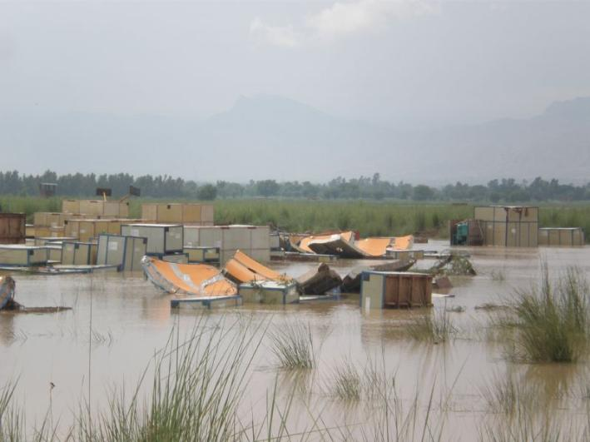
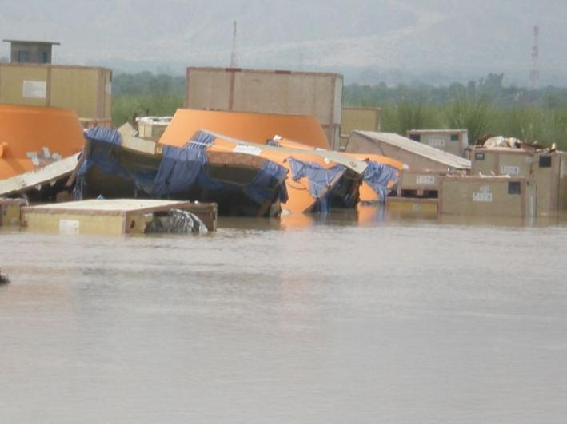
Unopened equipment submerged
Unopened equipment submerged

Slide 27
CC Gas Turbine IPP
175 Mw IPP - 120.9 Mw Gas Turbine & 64.2 Mw steam turbine
Recurring combustion nozzle damages during commissioning
Cause was unsuitable specifications of Fuel gas
LEG 3/96 cover was available – Design faults covered
COD delayed by 13 months

Slide 28
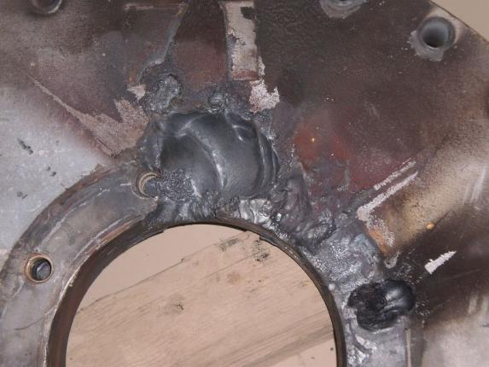
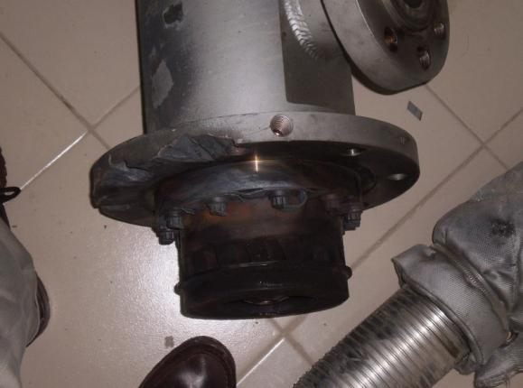
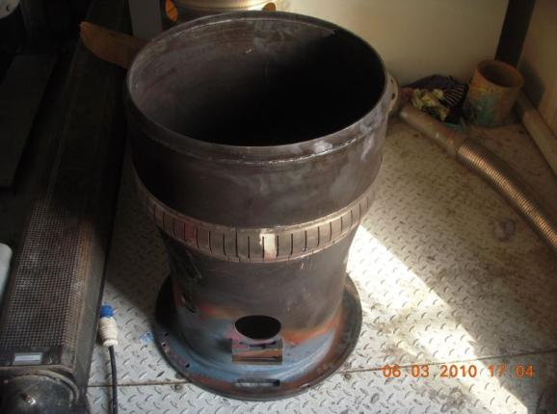
Burnt nozzle assembly
Nozzle cover damaged
Damaged flow sleeve

Slide 29
Lessons to be Learnt
Return period basis needs to be reviewed
Safe Storage of equipment and materials during erection
Periodic risk surveys during Construction & Operations
Awareness of LEG coverage
Awareness and understanding of DSU/BI basis for assessment
Use of specialists to assist with complex losses
Creating shared inventory pool of critical equipment
Owners investing in HR training and development

Slide 30
Thank You

